Slide 1
PrEP and Key populations: WHO guidelines & recommendations
.
Michelle Rodolph, WHO, HIV Department, Switzerland
24 July 2018
www.who.int

Slide 2
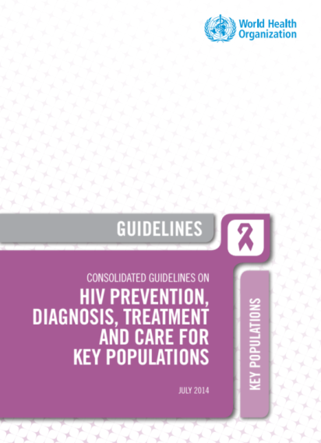
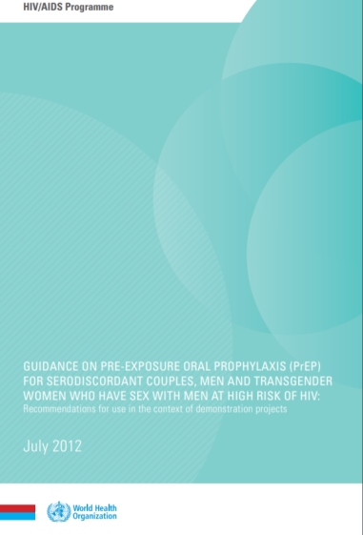
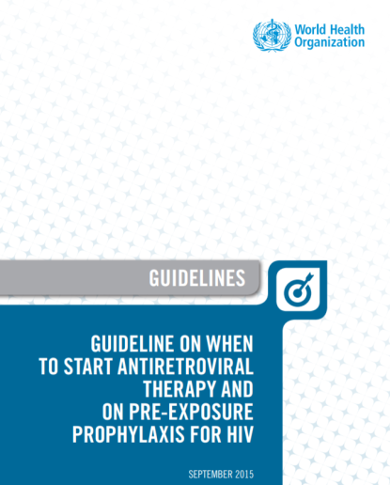
Evolution of WHO PrEP recommendations (Part I)
PrEP for MSM
(strong recommendation)
Other Key populations
(condit’l recommendation; no recommendation for PWID)
PrEP for SDC, MSM and Trans people
cond’l recommendation in the context of demo projects)
2014
2012
PrEP for people at substantial HIV risk
≈3 per 100 person years
strong recommendation
.
2015

Slide 3
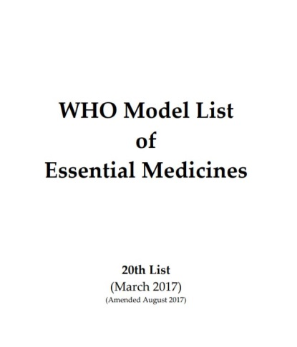
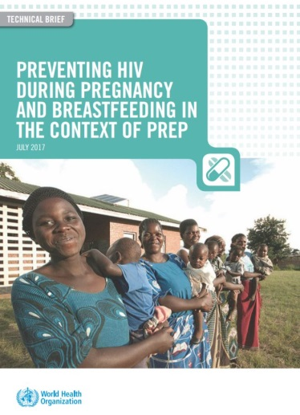
Evolution of WHO PrEP recommendations (Part II)
PrEP drugs on EML
(TDF/FTC, TDF/3TC, TDF)
WHO update on PrEP use during pregnancy and breastfeeding
March 2017
July 2017
.

Slide 4
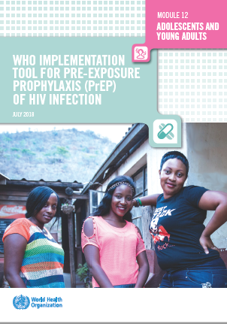
WHO PrEP Implementation Tool: practical suggestions
Modular
Different audiences
Different settings and populations
Suggestions, not recommendations
not WHO recommendations)
Learn as implement
Frequent updating anticipated
.
July 2017
July 2018

Slide 5
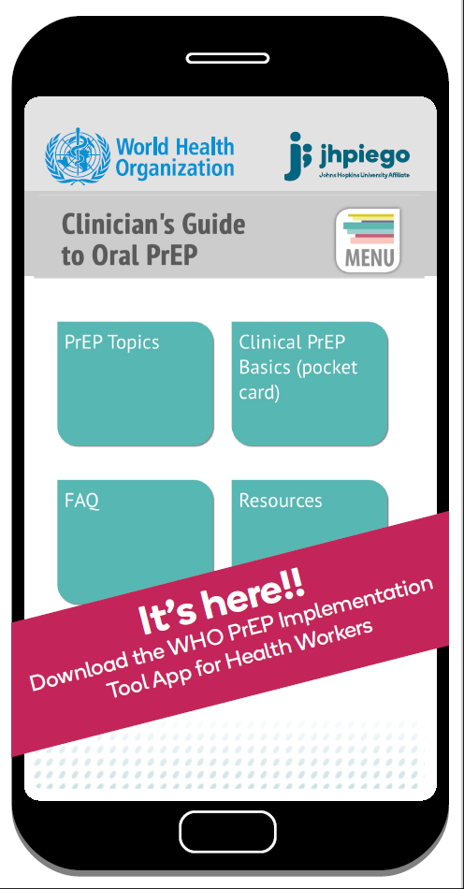
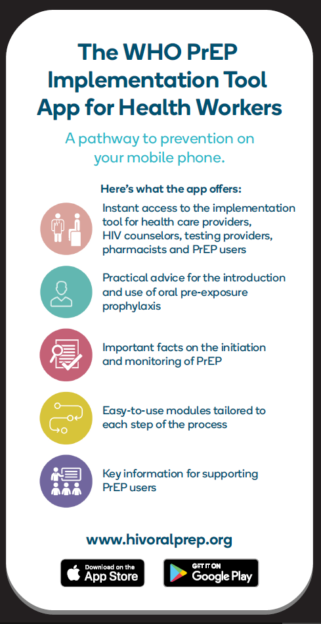
Announcing the launch of the WHO PrEP Implementation Tool App for Health Workers
.

Slide 6
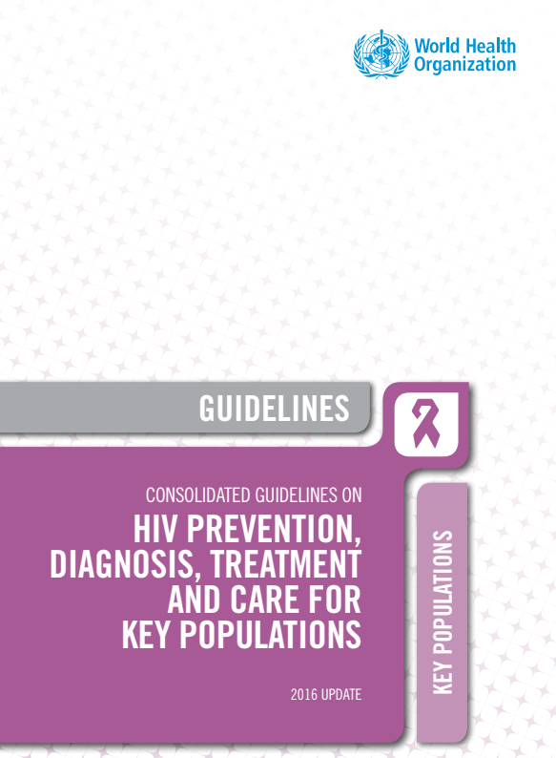
Key populations
Men who have sex with men
Transgender people
People who inject drugs
People in prisons or other closed settings
Sex workers

Slide 7
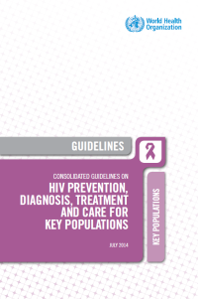
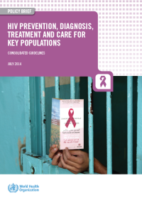
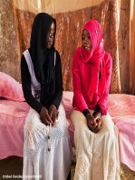
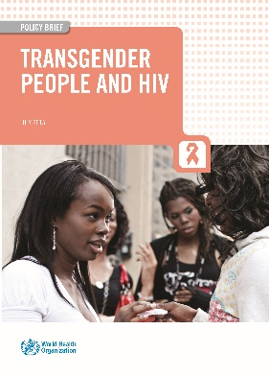
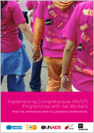
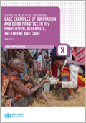
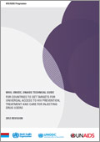
‘key’ Key Population publications
Guidelines - Consolidated Guidelines on HIV Prevention, Diagnosis, Treatment and Care for Key Populations - normative and Policy brief - for advocacy 2014, updated in 2016’
Young key populations technical briefs
Implementation tools
SWIT 2013
MSMIT 2015
TransIT 2016
DUIT 2017
Target setting guides
PWID 2009, 2012
All KP 2015
Transgender technical update 2015
Case examples: Serving The Needs of Key Populations: Case Examples of Innovation and Good Practice In HIV Prevention, Diagnosis, Treatment and Care 2017

Slide 8
Key populations: comprehensive package of service
HIV prevention
Harm reduction interventions for people who use drugs
HIV testing services
HIV treatment and care
Prevention, management of co-infections & comorbidities
Sexual and reproductive health interventions
Supportive legislation, policy and funding
Addressing stigma and discrimination
Health services available, accessible and acceptable
Community empowerment
Addressing violence
Health interventions
WHO positions
structural interventions within a comprehensive public health approach
Structural
interventions
Source: WHO Consolidated guidelines on HIV prevention, diagnosis, treatment and care for key populations

Slide 9
WHO Recommendation on PrEP
Oral PrEP (containing TDF) should be offered as an additional prevention choice for people at substantial risk of HIV infection as part of combination prevention approaches.
Provide PrEP within combination prevention
Condoms and lube
Harm reduction
HIV testing and linkage to ART
Provide PrEP with comprehensive support
Adherence counselling
Support: Legal, social, emotional support
Contraception and reproductive health services
For PWID, addition to harm reduction, and not an alternative
Which has proven to be extremely effective and cost effective
Not implemented (to scale) in most countries
Notes:
Replace with 2016 cover (consolidated ARV)

Slide 10
PrEP: key considerations
Not for EVERYONE
Uptake and continuation is variable
Not for ALWAYS
Seasons of HIV risk
Adherence is critical for PrEP effectiveness
Other services beneficial, valued and necessary
Many benefits beyond PrEP itself
How to implement strategically
Start in the highest incidence areas
Start with highest incidence groups
KPs (e.g. MSM, TG,)
SDC
Other populations?
Integration and linkages to existing services
Source: WHO PrEP implementation tool

Slide 11
Acknowledgments
WHO HIV Department
Shona Dalal
Annette Verster
Rachel Baggaley
Yannis Mameletzis
Virginia Macdonald
WHO regional and country offices
GDG members and reviewers whom have contributed to WHO guidance, Technical briefs and implementation tools on PrEP

